Slide 1
Capstone Project (Background and Objectives) HR Analytics: To develop scientific method of understanding factors that lead to Attrition in an organization

Slide 2

Background
Client
A healthcare R&D organization
Background
The company 1470 employees . Over the last year , The HR team has collected and consolidated information through various sources ( like survey , appraisal report, salary structure etc. ) about each employee
The company wants to understand what parameters impact the attrition in the organization and how can they make the work place a more conducive environment

Slide 3
Background
Objective
To analyze attrition and correlate with other factors
To develop employee attrition model
To analyze employee sentiments

Slide 4
Background
4. Data
The data used for the same is the employee data as on 31st Dec ’2022
The data available is the following :
Employee Attrition
Employee Demographics
Employee Income
Employee Job details
Exit Interview Responses

Slide 5
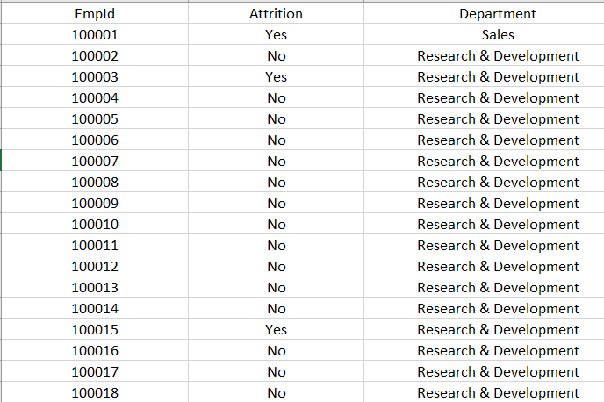
Data : Employee Attrition
Content
This data is mainly to understand whether the Employee has resigned or not anytime in the year 2022
Columns | Description | Type | Measurement | Possible values
EmpID | Employee ID | numeric | - | -
Attrition | whether he has resigned anytime in the year ‘19 | Factor | - | Yes, No
Department | Department | Factor | - | Sales , HR , R&D

Slide 6
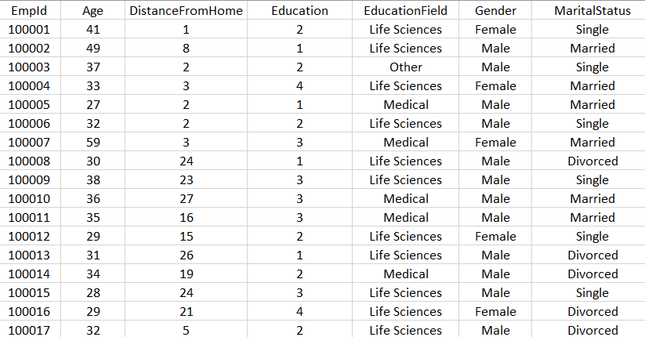
Data : Employee Demographics
Content
This data is mainly about the demographic factors of the employee
Columns | Description | Type | Measurement | Possible values
EmpID | Employee ID | numeric | - | -
Age | Age of the employee | numeric | - | -
DistanceFromHome | Distance from home in kms | numeric | - | -
Education | Score based on level of education | ordinal | 1 'Below College' 2 'College' 3 'Bachelor' 4 'Master' 5 'Doctor' | 1,2,3,4,5
Educationfield | Field of Education | factor | - | -
Gender | Gender | factor | - | Male, Female
MaritalStatus | Marital Status | factor | - | Single , Divorced , Married

Slide 7
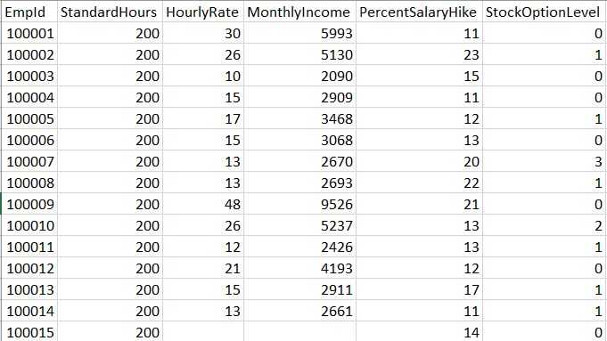
Data : Employee Income
Content
This data is mainly to understand his income components
Columns | Description | Type | Measurement | Possible values
EmpID | Employee ID | numeric | - | -
StandardHours | Minimum no of hours to be spent at work in a month | Numeric | Since all are full time employees , 200 is the std hours across | 200
HourlyRate | How much does the employee make per hour | integer | - | -
MonthlyIncome | Monthly Income | Numeric | - | -
PercentSalaryHike | Field of Education | Factor | - | -
StockOption Level | No of stocks as a part of compensation benefits | Factor | 0- none 1- <20 2-21-40 3->40 | 0,1,2,3,

Slide 8
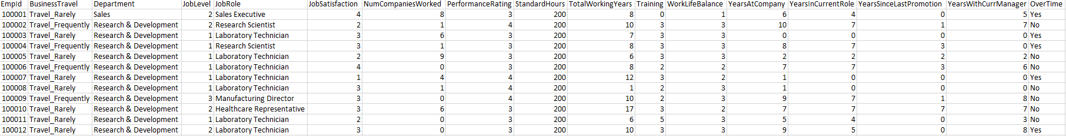
Data : Employee Job Details
Content
Content
This data is mainly to understand his job details .
Columns | Description | Type | Measurement | Possible values
EmpID | Employee ID | numeric | - | -
BusinesTravel | Does the employee need to travel for work : Never , Rarely or Frequently | factor | - | Non-Travel, Travel_Rarely, Travel_Frequently
JobLevel | Level of Job. | Ordinal | 1 =lowest ;5-highest | 1,2,3,4,5
JobRole | Job Role | Factor | - | -
Jobsatisfaction |  | Factor | 1=Low; 2=Medium; 3=High; 4=Very High | 1,2,3,4
NumCompaniesworked | No of Companies worked previously | integer | - | -
PerformanceRating |  | Factor | 1=Low; 2=Good ;3=Excellent; 4=Outstanding | 1,2,3,4
Overtime | If the person has worked over 250 hrs in the month, OT= Yes | Factor | - | Yes,No
TotalWorkingYears | Total years of Experience | integer | - | -
Trainings | No of Training programs attended in | integer | - | -
WorkLifeBalance | Rating based on a survey conducted for work life balance | Ordinal | 1=Bad; 2=Good; 3=Better; 4=Best | 1,2,3,4
YearsAtCompany | No of year spent in the current organzation | integer | - | -
YearsatCurrentRole | No of years in the current role | Integer | - | -
YearssinceLastPromotion | No of years since the last promotion | Integer | - | -
YearsWithCurrManager | No of years with current manager | Integer | - | -

Slide 9
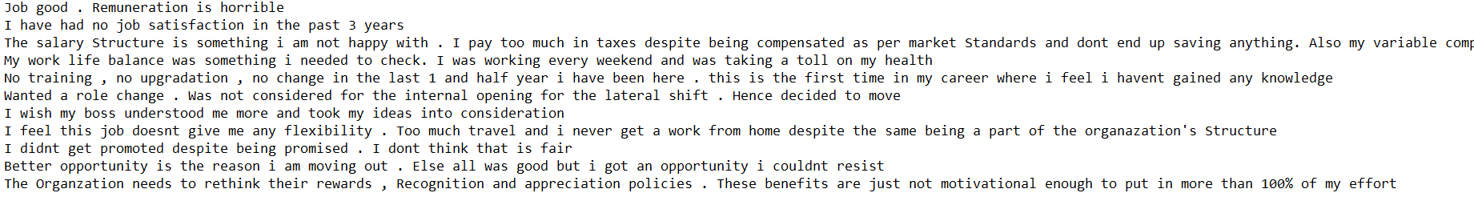
Data : Exit interview responses
Content
The response captured for the question “What is the main reason for your resignation ? You can be completely honest as this response is anonymous
Sample Size : 50
Description | Type
Consumer Responses | text

